Slide 1

Young Men who Have Sex with Men in Latin America
Carlos F. Cáceres, MD, MPH, PhD
Center for Research in Sexuality, AIDS and Society
Universidad Peruana Cayetano Heredia, Lima, Peru
Notes:
Good morning everyone. I would like to thank the organizers for this invitation.

Slide 2
Acknowledgments
Universidad Cayetano Heredia
  Michael Reyes
  Juan Carlos Enciso
  Fernando Olivos
  Oliver Elorreaga
Fiocruz/ImPrEP
  Beatriz Grinsztejn
  Valdilea Veloso
  Raquel de Boni
  Thiago Torres
RIGHT+/CELAMIS
Ministry of Health of Peru
  Program of HIV/STI/Hepatitis
  Division of Epidemiology
University of Bahia/PrEP15-19
  Ines Dourado
UCSF
  Susan Kegeles
  Andres Mayorana
UNAIDS, WHO, UNICEF
  Peter Ghys
  Keith Sabin
  Giovanni Ravasi
  Alejandra Trossero
Other/Mixed
  Maria Veras (SCSP, RIGHT+)
  Hamid Vega (ImPrEP Mexico)
  Ricardo Baruch (INSP Mexico)
  Stef Baral (JHU)
No conflicts of interest to declare.
Notes:
I am pleased to acknowledge the valuable support of many friends and colleagues.

Slide 3
Outline of this Presentation
Definitions
Epidemiology of HIV and STIs in LAC
Sexual Risks and Access to Services
Social Determinants
Intervention Models/Experiences
Take-Home Messages
Notes:
Today I plan to cover some definitions; the epidemiology of HIV and STIs in this group; sexual risks and access issues, as well as their social determinants; and a few intervention models that have been studied in the region; to conclude with some take-home messages.

Slide 4
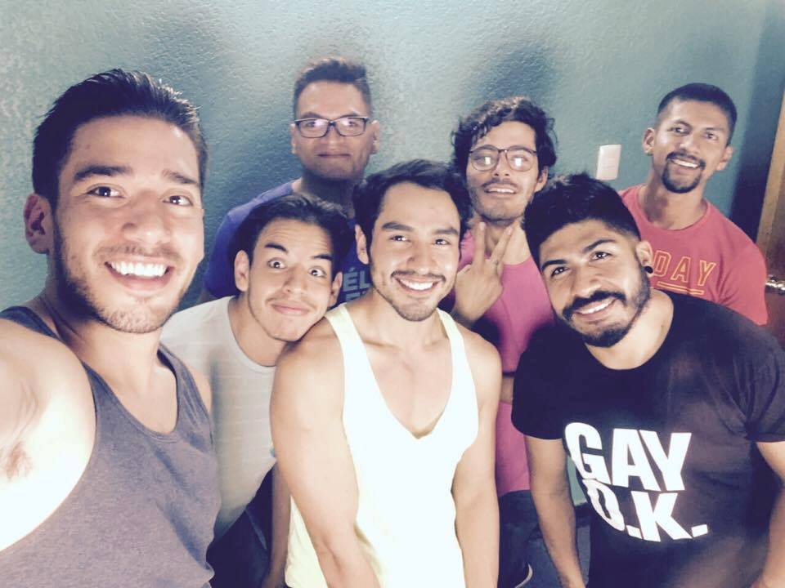
Notes:
But let’s start acknowledging that we are talking about human beings, like those in this group of Young Mexican gay men. For example, let’s talk about Jorge.
A 23 year old employee, Jorge got HIV from a boyfriend he had been going out with for a few months. Upon his diagnosis, he started free treatment through the Mexican Institute of Social Security. He had excellent adherence to ART, and remained undetectable until 3 months ago, when he had to stop treatment due to a shortage of ARTs. He has also developed anal warts, and has been waiting for surgery for months, since he can’t pay for the procedure elsewhere. He feels that his doctor does not treat him well, apparently due to his sexual orientation…
Let’s keep in mind this concrete personal story while we move on…

Slide 5
About Whom?
‘Adolescents’ (10-19), ‘youth’ (15-24), ‘young people’ (10-24) (WHO)
Focus on 15-24 y.o., in 2 groups:
  15-17 (older adolescents: ‘minors’, restricted rights)
  18-24 (‘young adults’ or ‘emerging adults’)
‘Young gay and other MSM’
  Identity and/or behavior
  Legal age of consent is relevant
Spanish and Portuguese-Speaking LAC
Transwomen not included here – distinct group with specific needs
Notes:
According to WHO, there are various overlapping technical definitions related to Young people. Here we are focusing on young men, 15 to 24 years old, recognizing that they comprise two groups: those 15 to 17 yo, who are legally minors, with restricted rights, and those 18 to 24, who are, say, emerging adults.
As this goes beyond identity, we say: ‘Young gay and other men who have sex with men’, recognizing that there are issues about age of consent to consider.
What I will say will mostly apply to Spanish- and Portuguese-speaking populations. And, I was not asked to include transwomen, as they have distinct needs and concerns.

Slide 6

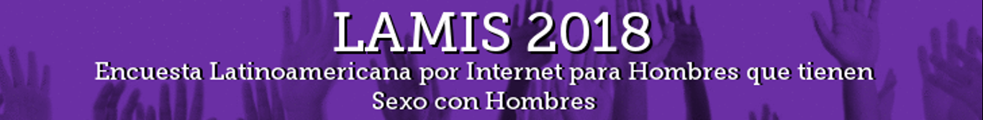

Epidemiology of HIV and STIs
Key Data Sources:
Latin American MSM Internet Survey (65000+ MSM from 18 LA countries over the internet, 2018)
ImPrEP On-line survey (Formative Study for ImPrEP, in Brazil, Mexico and Peru, 2018)
UNAIDS country reports
MoH Data from Brazil and Peru
Notes:
Let’s move to some epidemiologic data. It is also the time to briefly mention that many of my points will be illustrated by data from the following sources:
First, the Latin American MSM Internet Survey, LAMIS, with on-line responses from over 65,000 MSM from 18 Latin American countries in early 2018. Please look for the LAMIS oral and poster presentations at this conference.
Second, the ImPrEP On-line Survey, conducted as a formative component of the ImPrEP demonstration study in Brazil, Mexico and Peru, with responses from nearly 20,000 MSM. Please look for the ImPrEP oral and poster presentations at this conference.
Third, the UNAIDS country reports
And fourth, data from case notification and behavioral surveillance from Brazil and Peru.

Slide 7

HIV Prevalence among MSM by Age Group, LAMIS 2018
Notes:
Here and in many other figures I will compare two age groups: Young MSM 18-24, and older MSM, over 24. This is the LAMIS online survey. When we look at HIV prevalence data in both groups, there is variation across countries, and the overall prevalence among Young MSM is 6.5%, while it is 20.5% among older MSM.

Slide 8
A New Epidemic Wave?
(LAMIS)
HIV diagnoses over the past 12 months is a proxy for HIV incidence
This measure is very similar for both age groups, around 3% per year.
Notes:
However, when we look at reports of HIV diagnoses during the past 12 months, Young and older MSM report similar figures, around 3% per year. This is a proxy for HIV incidence, and is quite high.

Slide 9
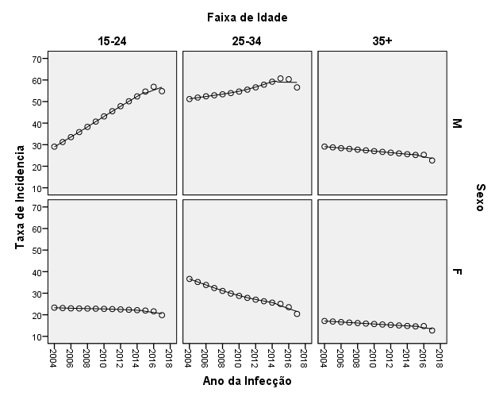
Annual HIV Reporting Trends by Gender & Age Group, Brasil, 2004-2017, MoH
For Infections In the 15-19 y.o. age group:
Year of diagnosis | Male (Exposure Categories) |  |  |  | Female | Total
 | MSM | Heteros. | IDU | Total
2009 | 154 | 58 | 10 | 221 | 358 | 579
2010 | 215 | 52 | 12 | 279 | 431 | 710
2011 | 278 | 93 | 7 | 378 | 450 | 828
2012 | 452 | 99 | 9 | 560 | 543 | 1103
2013 | 633 | 143 | 13 | 789 | 684 | 1473
2014 | 963 | 230 | 18 | 1211 | 786 | 1997
2015 | 1321 | 266 | 26 | 1613 | 900 | 2513
2016 | 1391 | 254 | 19 | 1663 | 938 | 2603
2017 | 1514 | 310 | 15 | 1840 | 843 | 2683
Total | 6936 | 1495 | 124 | 8554 | 5933 | 14489
Age Range | M |  | F
 | Rate (%) | p value | Rate (%) | p value
15-24 | 5.2% | <0,001 | -0.8% | <0,001
25-34 | 1.2% | <0,001 | -3.9% | <0,001
35+ | -1,5% | <0,001 | -1,7% | <0,001
T | 1,1% | <0,001 | -2,3% | 0,001
Notes:
This is compelling information from HIV surveillance in Brazil. The upper left-hand figure shows the progression of annual HIV reporting by gender and age group between 2009 and 2017. One group grows steadily across that decade: Young males 18 to 24.
When we look at transmission categories among those young males, 81% are classified as MSM.

Slide 10
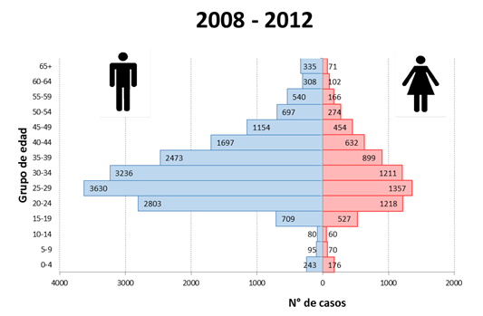
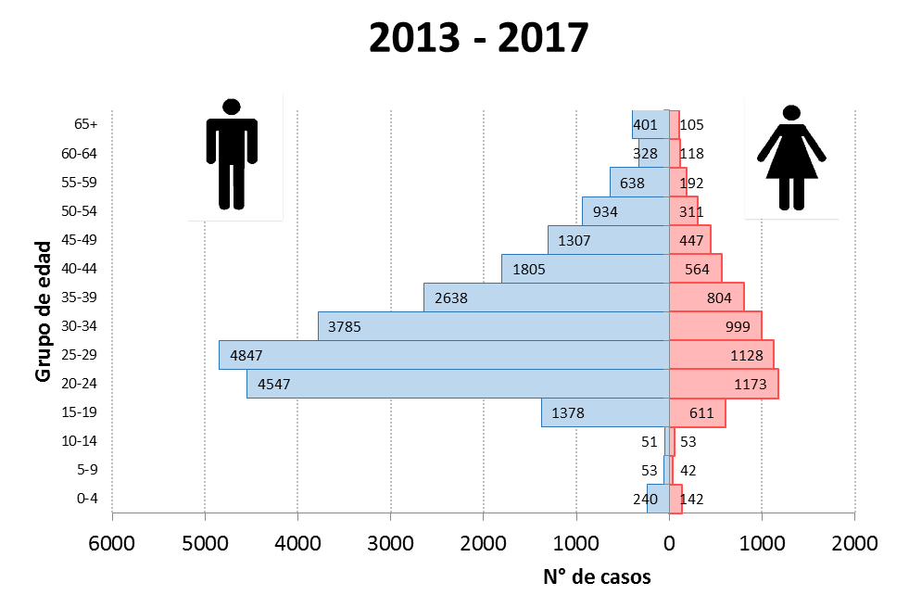
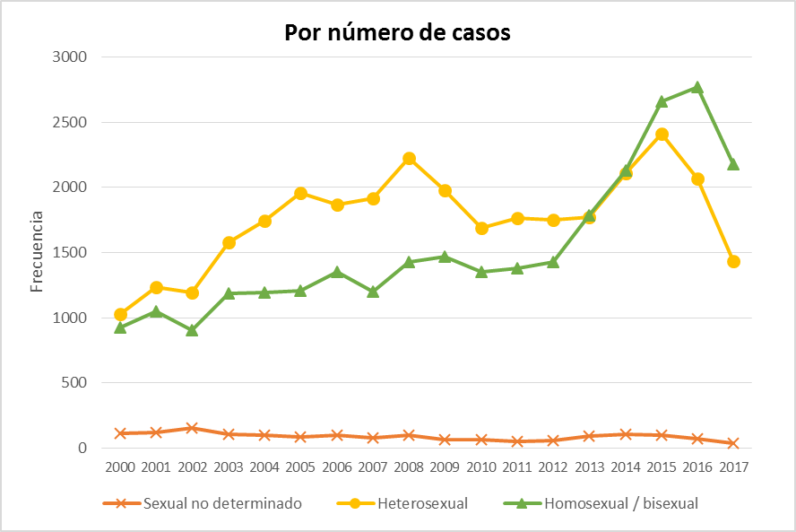
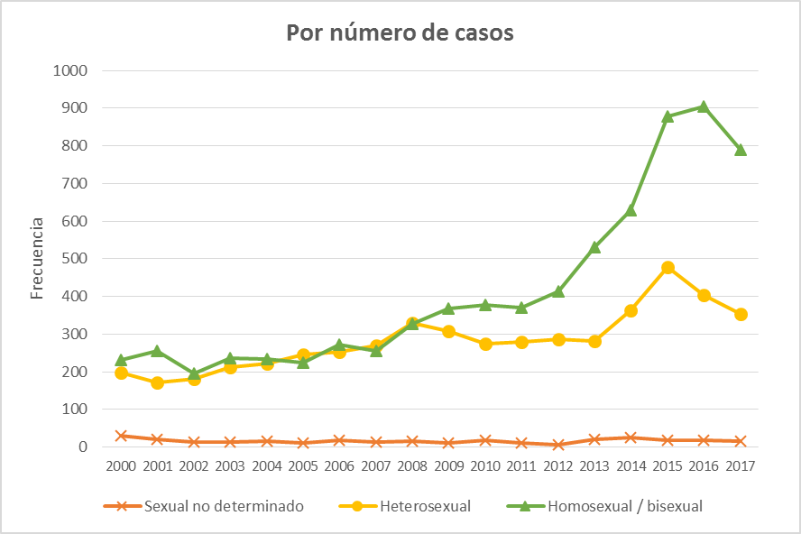
HIV Infections Notified by Gender and Age Group, Peru 2008-2017 (MoH)
Reported cases of HIV infection by age, sex and five-year periods. Peru, 2008-2012 / 2013-2017 (absolute figures)
Cases of HIV infection in men 15-24 years, based on likely mode of infection. Peru 2000-2017
Cases of HIV infection in men 15 + years, based on likely mode of infection, Peru 2000-2017
Notes:
Now let’s look at HIV reporting in Peru. The upper figures allow us to compare case reporting for two 5-year periods: 2008-12 and 2013-17. Cases reported among the 15-19 and the 20-24 groups taken together went up from 3500 to almost 6000, that is, a 68% increase, higher than in any other group.
The two bottom figures portray the evolution over time of heterosexual and homosexual cases among males, clearly showing an increase in homosexual transmission, while heterosexual tranmission remains stable. This change started to appear among the 15 to 24 group as early as 2008.

Slide 11
New HIV Infections by Gender (15+)
Latin America, 2000-2015
Source: UNAIDS, Spectrum estimates 2015
Notes:
The examples of Brazil and Peru are consistent with the regional pattern of a concentrated epidemic: About two thirds of new HIV infections among 15-24 year olds in 2016 took place among males.
The lower right-hand figure shows that such trend is becoming bolder over time, and that the annual figures have continued to grow among young males while remaining stable or even descending among females.

Slide 12
Syphilis, NG or CT in last 12 months among MSM<25 y.o, LAMIS
Almost 9% of MSM 18-24 years old in the LAMIS study reported having been diagnosed with either syphilis or Chlamydia or gonorrea over the past 12 months.
Notes:
Now, about STIs: Almost 9% of the 18-24 LAMIS participants reported having been diagnosed with either syphilis or Chlamydia or gonorrea over the past 12 months. This is clearly a high figure.

Slide 13
Sexual Risk, Vulnerability and Access to Care and Prevention
Notes:
Now let’s move to data on sexual behavior, access to care, and social vulnerability.

Slide 14
Notes:
This figure about self-perceived HIV risk shows that, despite the high HIV and STI rates observed, the majority of these men consider themselves to be at low risk. Those figures are somewhat higher among Young MSM.

Slide 15
HIV Testing Practices by Age Group, LAMIS
Half of participants 18-24 at risk for infection reported having been HIV tested in prior 12 months, compared to 2/3 of participants 25 or older.
Notes:
This other figure from LAMIS shows that about half of Young MSM reported having been tested in the prior 12 months, less than the 2/3rds who did so among those older.

Slide 16
The Cascade of HIV Care among Adolescents (12-17 y.o) as of Dec 2017 in Peru (MoH)
In Relation to the 90-90-90 Goals among Adolescents (12-17 years) through December 2017, gaps are 17% to reach 90% diagnosed; 15% to reach 90% on treatment; and 42% to reach 90% virally suppressed.
Notes:
This is an estimation of the HIV care cascade for adolescents 12 to 17 in Peru as of 2017, as well as of the gaps to reach the 90-90-90 goals.
As we can see, gaps are 17% to reach the 90% diagnosed; 15% to reach 90% on treatment, but 42% to reach 90% of viral suppression.

Slide 17
Proportion of HIV-diagnosed participants on ART, and proportion of viral supression among them by age group, (LAMIS 2018)
<25 years old
25+ years old
Notes:
In this figure from LAMIS we see the proportions of HIV diagnosed participants in the two age groups. Overall, among young MSM who report an HIV diagnosis, 80% report having started ART, but only 64% report viral suppression, compared to 90% and 84% among older MSM, respoectively. This means that, for various reasons, levels of access to treatment and especially viral suppression are clearly lower among young MSM.

Slide 18
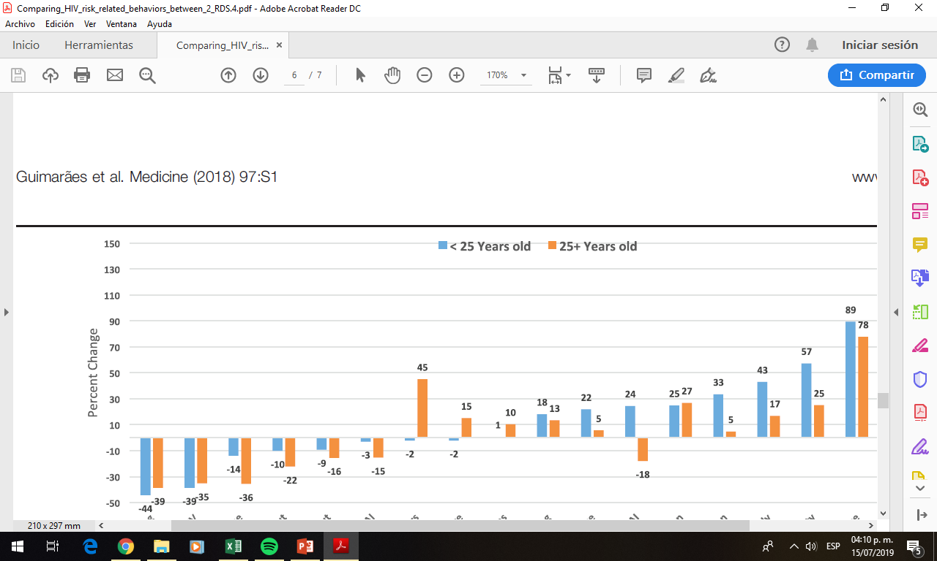
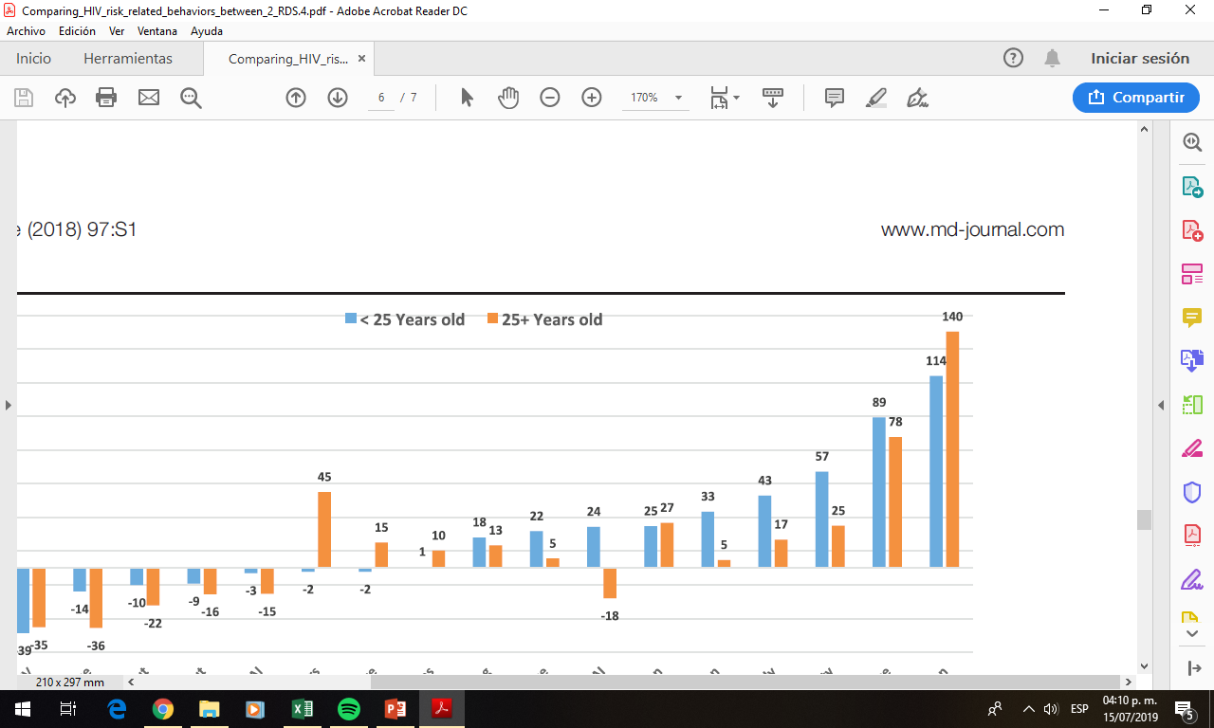
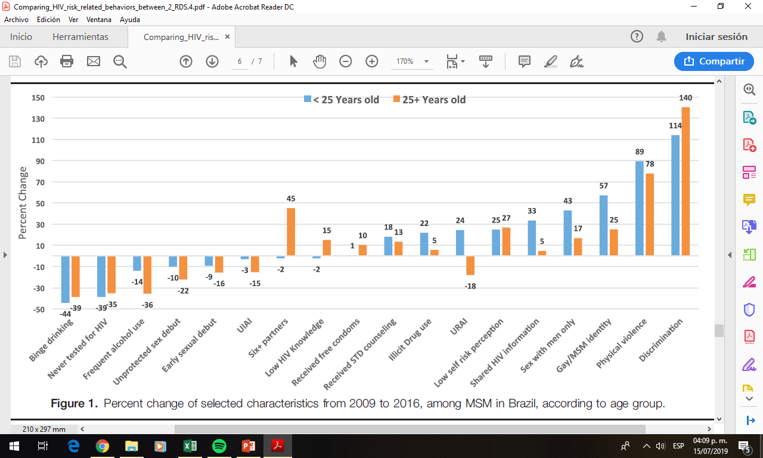
Sexual Behavior
In Brazil, Guimarães et al. (2018) compared the 18-24 age groups of 2 RDS samples of MSM:
2009, N=1736; and
2016, N=2503
Some progress:
  Less binge drinking (44%)
  Less people reporting no prior HIV testing (39%)
  More access to information and services
Some challenges:
  URAI increased by 24%
  Illicit drug use increased by 22%
  Low risk self-perception increased by 25%
Notes:
What about sexual behavior? In Brazil, Guimaraes and collaborators compared the younger groups of 2 RDS samples of MSM, from 2009 and 2016, respectively
Among young MSM there was some progress; for example, less binge drinking, more HIV testing, and more access to information and services. However, some challenges emerged: Unprotected receptive anal sex increased by 24%; illicit drug use increased by 22%, and low risk self-perception increased by 25%.

Slide 19
25% of MSM 18-24, compared to 28% of MSM 25 or older, reported any condomless Anal Sex with a Non-Steady Sex Partner of Unknown Serostatus, over the past 12 months (LAMIS)
11% of MSM 18-24, compared to 15% of MSM 25 or older, reporting having used drugs to increase the intensity and duration of sex over the past 12 months to Enhance Sex (LAMIS)
Notes:
Also from LAMIS, MSM of both groups report similar frequencies of condomless anal sex with a non-steady partner of unknown serostatus, and of recent drug use to enhance sex.

Slide 20
Notes:
These data from the ImPrEP online survey show that young MSM report more receptive and less insertive condomless anal sex than older MSM. This may reflect age-related changes in role preference or role negotiation, but also a power dynamics.

Slide 21
The Role of PrEP
Country | Guidelines | Demonstration project | National policy | Private sector
Argentina | Drafted | Planning | - | Yes ª
Bahamas (The) | Available | - | Yes | -
Barbados | Available | - | Yes | Yes ª
Bolivia | - | Planning | - | -
Brazil | Available | Implemented | Yes | -
Chile | Available | Planning | Planning | Yes ª
Colombia | - | Planning | - | -
Cuba | Available | - | Yes | -
Dominican Republic | Drafted | Implemented | Planning | Yes ^{b}
Guatemala | Available | Planning | Planning | Yes ^{b}
Haiti | Available | Planning | Yes | -
Jamaica | - | Planning | - | -
Mexico | Available | Implemented | - | -
Paraguay | - | Planning | Planning | Yes ^{b}
Peru | Available | Implemented | Planning | Yes ª
Latin American countries that have either implemented a demonstration project or have made PrEP available through a national policy as of December 2018
Notes:
Awareness about PrEP among Young MSM ranged between 61% in Brazil and 37% in Peru. This may be explained in part by the PrEP policy approved in Brazil in December 2017, and by the proximity to PrEP information from the US in Mexico. In Peru and most Latin American countries, the topic is still being introduced.

Slide 22
PEP Use by Sub-Region and Age Group (LAMIS)
PrEP Use by Sub- Region and Age Group (LAMIS)
Notes:
These are figures for both PEP and PrEP use by age group.
Despite their reported high behavioral risk, only 2.4% of young MSM, and 5% of older MSM reported any PEP use in the past. This may be due to low availability or low awareness of non-occupatioal PEP.
The figures are even worse for PrEP use, reported by only 0.6% of Young MSM, and 1.3% of older MSM. This means that access to both PEP and PrEP among Latin American MSM remains marginal.

Slide 23
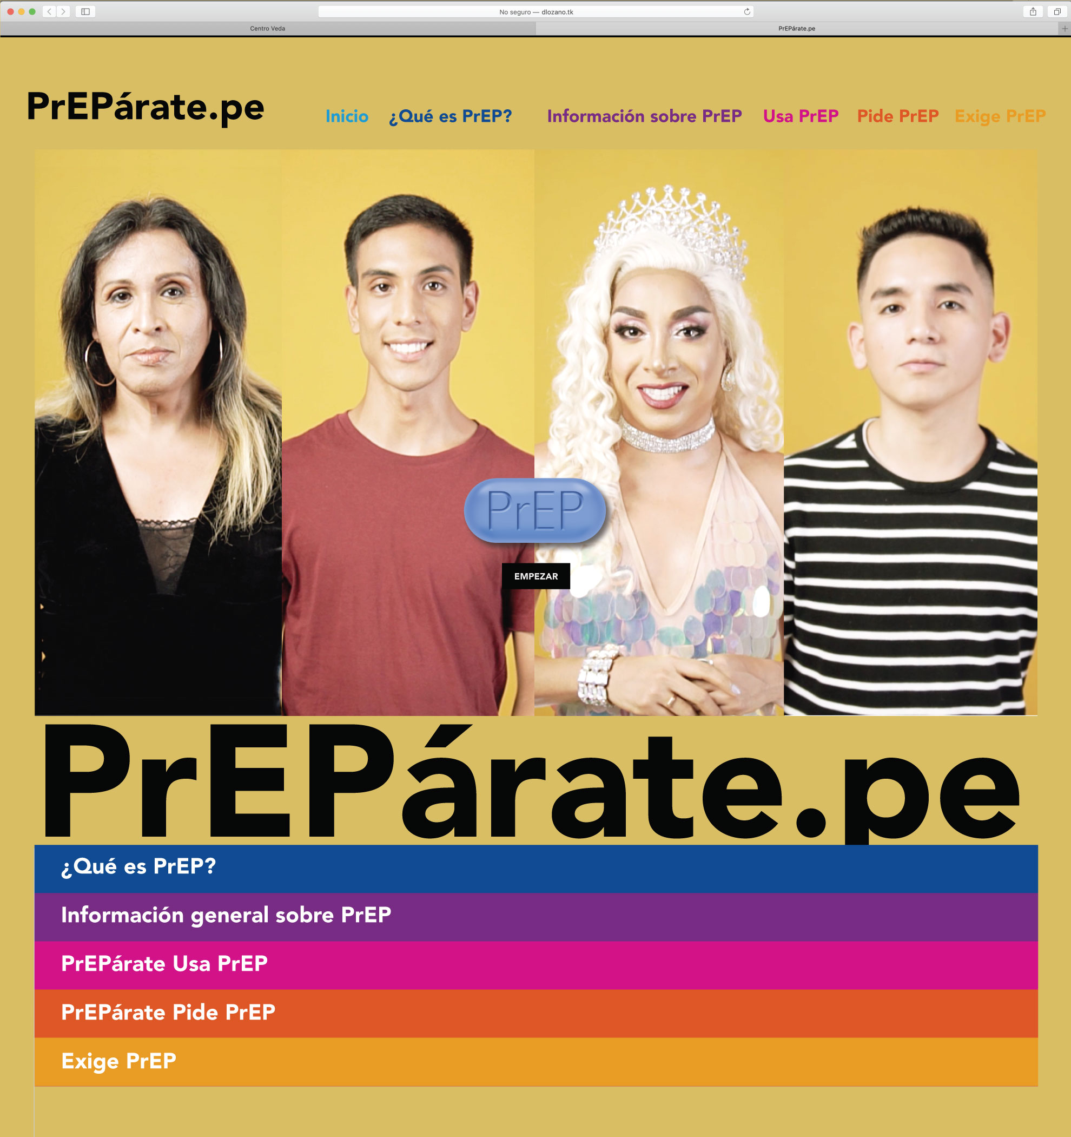

Notes:
Interestingly, willingness to use PrEP is similar across both age groups, between 50 and 60%.

Slide 24
Mental Health
Depression and/or Anxiety Symptoms in last 2 weeks (LAMIS):
  Any: 18-24 y.o: 61.7%
  25+y.o.: 54.4%
Frequency of Suicidal Ideation in last 2 weeks (LAMIS)
  Any freq: 18-24: 36.1%
  25+: 25.7%
Notes:
Often neglected, mental health is critical in discussing the experience of young MSM. In the LAMIS study, 62% of Young MSM, compared to 54% of older MSM, reported symptoms of anxiety and/or depression in the past 2 weeks. Likewise, 36% of young MSM, compared to 26% of older men, reported suicidal ideation in the past 2 weeks.

Slide 25
Alcohol and Drug Use (LAMIS)
Cannabis
Synthetic
Cannabinoids
Ecstasy, pills
Ecstasy, crys
LSD
Cocaine
Notes:
Concerning use of alcohol and drugs, also in the LAMIS study, Young MSM reported a slightly higher use of alcohol, at 23%, compared to 20% among older men. Likewise, the use of drugs in the past 12 months is similar across both age groups for most drugs.

Slide 26
Social Determinants of Risk and Vulnerability
Notes:
Let’s now talk about social determinants of vulnerability.

Slide 27
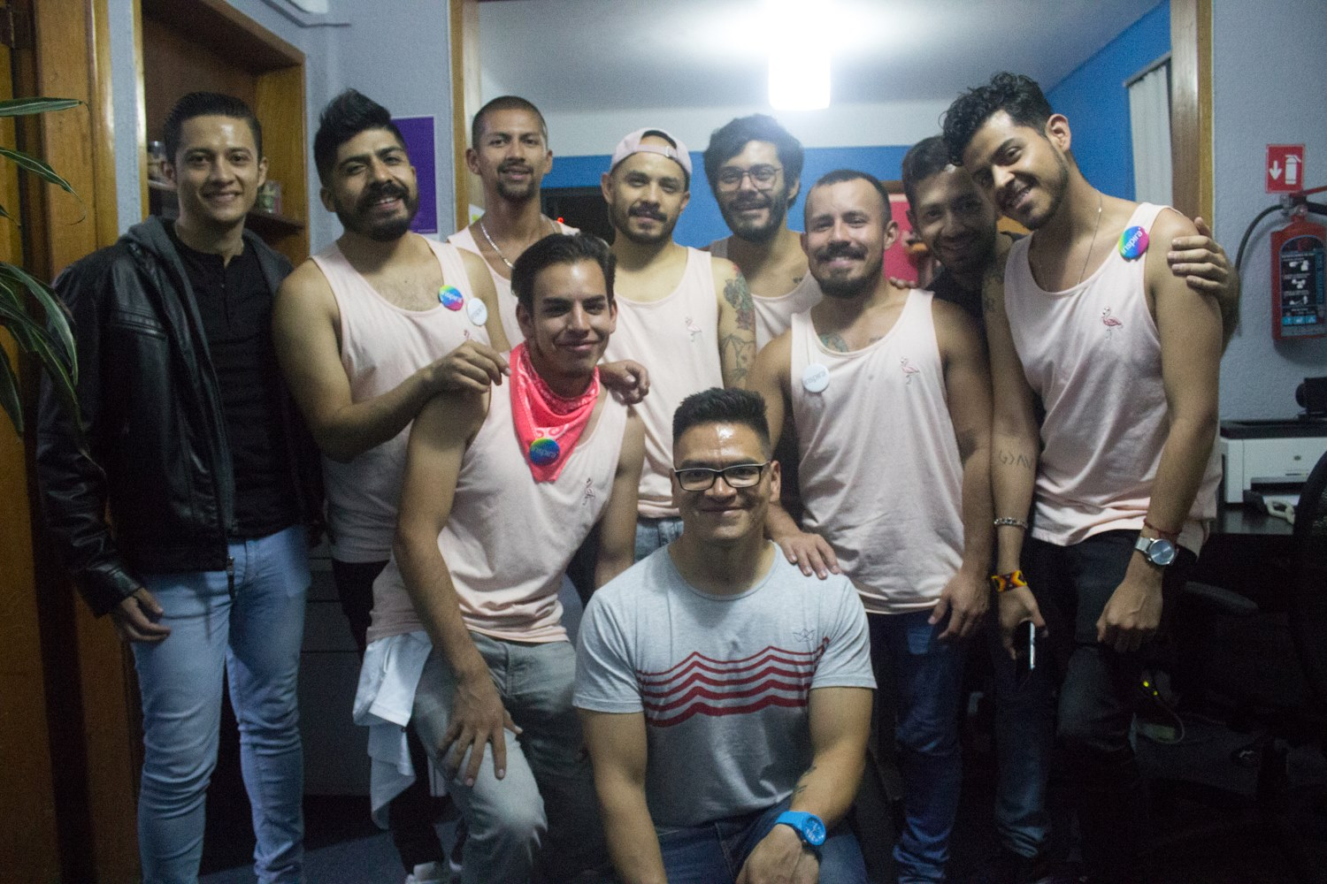
Notes:
But first let’s meet another young gay man. 21 year-old Marco works at a bank in a city of Northern Mexico. As many gay friends, he is constantly checking Grind*r, and meeting new people. He uses condoms regularly, but the guys he meets are increasingly asking for condomlesssex. Recently, after giving up and having raw sex with a new guy he liked, he freaked out. He knew about PEP, but was too embarrassed to go to a clinic and ask for it. Fortunately he came out negative, but now he fears it will happen again. He would like to try PrEP, but it is not available where he lives...

Slide 28
Structural Barriers in Access to Care
Legal Access to Quality Sexual Care
  59% (LA) 90% (Caribbean) of countries require parental consent for HIV-related services
Stigma and discrimination
  Legal barriers to same-sex sexuality: Not in Latin America, but some persist in the Caribbean
  Stigma and discrimination remain present
Lack of youth-friendly approaches
Notes:
Some of Marcos’ experiences illustrate the challenges that Young MSM in Latin America face to remain HIV negative. At least he is not a minor, as in many countries parental consent is required to access HIV-related services. While gay marriage has been legalized in Mexico and the legal framework is positive, he still feels others are judgmental about homosexuality, and is not comfortable talking to a provider about his private life. He also feels that clinics are odd and do not make people like him feel very well.

Slide 29
Changes in Mainstream Society and Gay Culture
Improved legal framework but persisting, covert, politically incorrect homophobia
Mainstreamed, sexualized, commodified gay culture
Considerable decay in condom use among MSM internationally, but:
  viral suppression (among HIV+) not so high;
  PrEP use is still marginal
New identities and forms of relationships
  Poliamory; non-binary gender identification
New sexual meanings and practices
  Barebacking as intentional condomless anal sex
  Group sex parties, new sex drugs
Notes:
Indeed, young MSM in the region are experiencing a world with many contradictory changes. The legal frameworks range from neutral to very positive. Several countries have approved same sex unions, and homophobic displays are becoming socially unacceptable. However, it may seem that legal recognition has favored the mainstreaming of a commodified and superficial version of gay culture.
Gay sexualities have changed as well, often adopting global innovations such as new sexual meanings, and more exciting but riskier sexual practices. The ongoing decay in condom use, observed among MSM of all ages, however, is taking place in context with larger gaps in HIV diagnosis, treatment and viral suppression, and marginal PrEP use, compared to high income settings.

Slide 30
The Internet: Impact on Sexuality
Radical transformation in communications and social interaction
  Impact on social life (device addiction)
  Impact on sexuality: Sexualization of Culture (mainstreaming of alternative sexual expressions)
    Free, unlimited access to: ‘new pornography’ (mostly condomless sex; often high risk, no social interaction) that may lead to ‘ritualized’ sexual expectations; amateur porn; interactive porn, music porn clips, etc.
    Normalization of Apps that facilitate finding new occasional partners through geolocation
Notes:
The world today cannot be imagined without the internet. It has caused a radical transformation in communications, social interaction and sexuality. It also has contributed to a sexualization of culture by mainstreaming a stereotypical view of various sexualities.
Sex-related searches, on-line pornography and apps remain among the most frequent motives of internet use to date. Its free, unlimited offer of all kinds of pornography is changing people’s perception of sexual normalcy and imposing unrealistic expectations that especially young people may not be able to assess critically.

Slide 31
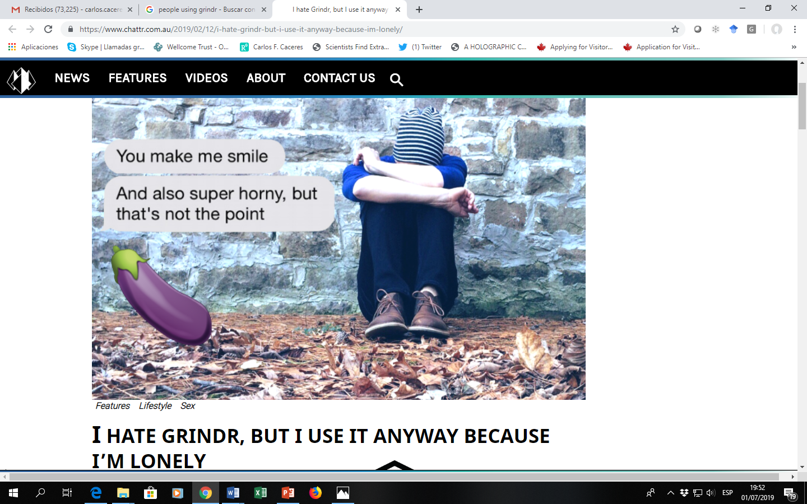
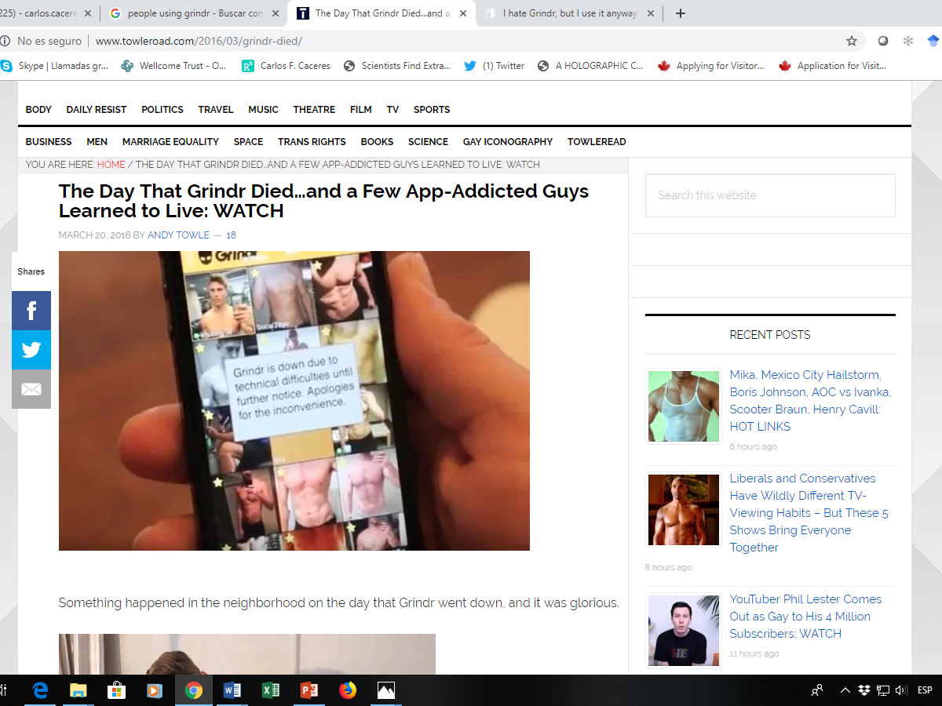
Notes:
The normalization of dating apps with geolocation, facilitates hook-ups significantly, and is changing the way people meet their sex partners.
Many people develop a love-hate relationship with them, and justify their use out of loneliness or boredom… And a few stop using them, claiming that these apps are really addictive…

Slide 32
Notes:
In one way or another, they have become very popular in both age groups. Between one third and one half of MSM in the ImPrEP on-line survey indicated high use of these apps.

Slide 33
Failure of Sex Education Policies
While contemporary culture/technology offers unlimited access to sexual content and contacts…
Other sectors remain discussing whether or not it is appropriate to offer sex education at school
Whatever sex education is offered, it is by no means sufficient to provide any meaningful support vis à vis the sexualized culture
Some parents hope to control the Sex Ed received by their children, although they are usually less computer-savvy and often less informed…
Notes:
In this radically changed environment, driven by new technology and the market, sex education policies are largely insufficient. In a context of unlimited access to sexual content and opportunities, policy makers continue to debate whether or not to offer sex education at school.
Whatever sex education is currently offered, it is by no means sufficient to provide meaningful support to young people. It should really be rethought.

Slide 34
Polarized Debate on Sexual Freedom
A polarization of the public debate on sexual freedoms (i.e. between no-sex and all-sex)
  Being positive towards sex (i.e. anti-oppression) may imply acceptance of sexuality with no restrictions – it is indeed a social norm.
  Nobody discusses, from a position of freedom and rights:
    what boundaries are relevant
    how to assess personal sexual needs
    Why people have sex and how to make it feel you more humaine, happier, more fulfilled.
In such context, young people may feel inclined to assume that more sex is always better.
Notes:
Today’s extremely polarized world hinders our ability to focus on balance. Fighting sexual oppression may give the impression that sexual freedom means no regulation, not even self-regulation. We may end up thinking that such sexual freedom is a measure of success, or happiness. And we may feel it makes sense to measure sexual freedom by the number of sex acts or sex partners we have. In such case, we might start feeling that we are being used, or that we are using other people. We might feel dehumanized. But likely we might continue with this because it adheres a strong social norm in gay culture, and provides temporary relief for other problems.
Young MSM who are learning to play the gay game will be likely to follow this path as long as there serious discussion about sexual lifestyles and choices within gay communities – and yes, it has to be an insider’s discussion, nothing imposed from the outside, as it would be oppressive. But Young people should be prompted to ask themselves why they have sex, what their personal sex needs are, and what they could do to ensure that their sex lives make them feel happier,, more fulfilled, more humaine.
In fact, from a public health point of view, we should ask ourselves if this might be a critical, so far neglected component of combination HIV prevention.

Slide 35
Experiences of Intervention among Young MSM in the Region
Ahora é Agora (Fiocruz, Brazil)
PrEP 15-19 (U. Bahía, Brazil)
Orgullo + (UPCH, Peru)
The Voice of Brazilian LGBT Adolescents (UNICEF/Brazil)
Notes:
Intervention strategies aimed at Young MSM in Latin America are almost non-existent. Let’s quickly review some of them.

Slide 36
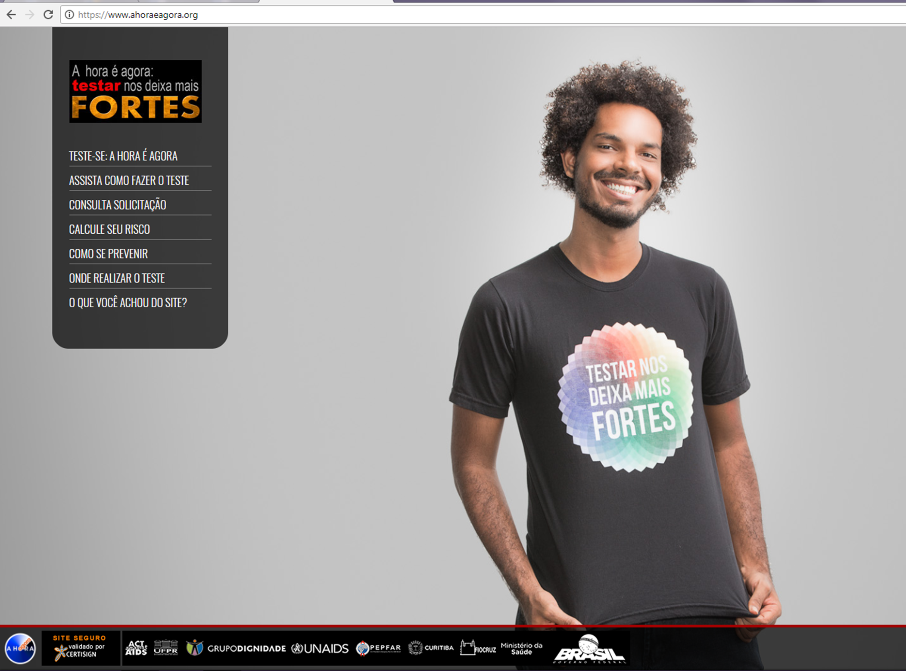
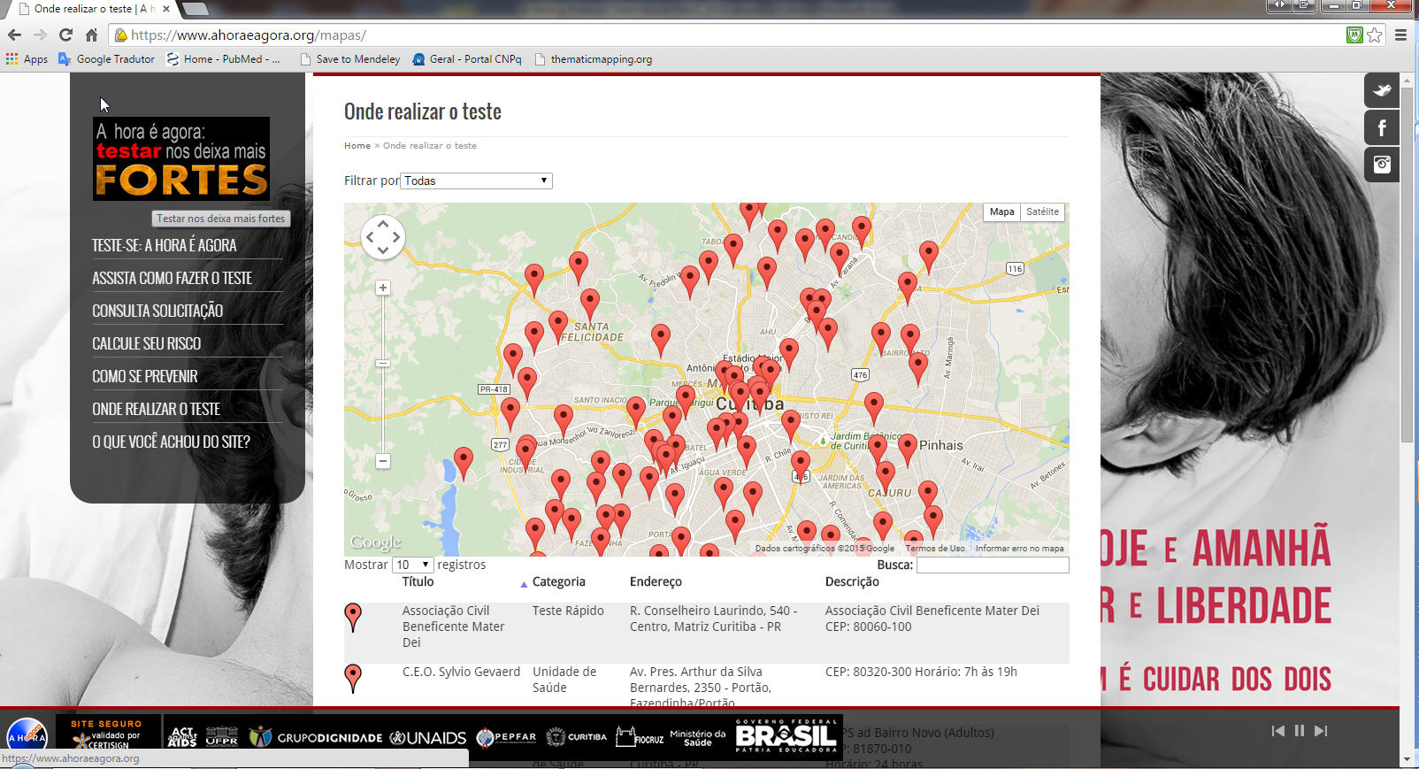
HIV Self-Testing: A Hora é Agora (The Time is Now)
  E-testing
  To develop, implement and evaluate the feasibility of a Web-based intervention that:
      Promote HIV prevention
      Provide free anonymous HIVST
      Promote linkage to care
  From 2015 to 2017-> A HORA É AGORA (Time is now)
  Community-wide intervention to increase HIV testing and linkage to care among MSM in Curitiba
      Web-based HIV self-testing (“E-testing”)
      Mobile testing (2 vans and 1 community LGBT NGO)
      Governmental public health facility (COA)
  Previous 12-month HIV testing increased from 21.2%(2009) to 43.9% (2016) among MSM in Brazil → not enough
Notes:
A Hora é Agora, The time is now, was a demonstration Project aimed at developing, implementing and evaluating for feasibility, a web-based intervention to promote HIV prevention, provide free, anonymous HIV self-testing, and ensure linkage to care among those found positive. Led by Fiocruz and collaborators, this community-wide program took place in Curitiba, Brazil, between 2015 and 2017, included HIV self-testing kits to order on-line, mobile testing units, and testing at public health facilities.

Slide 37

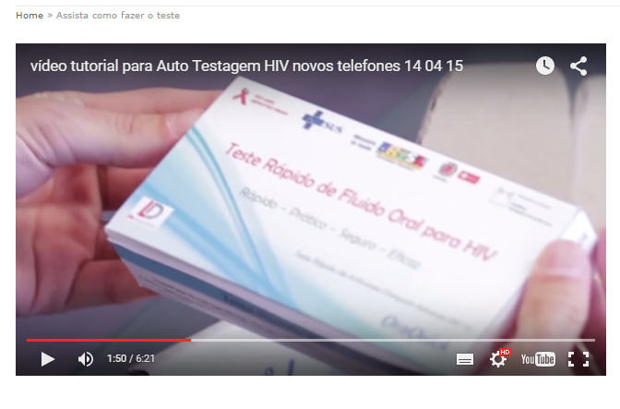

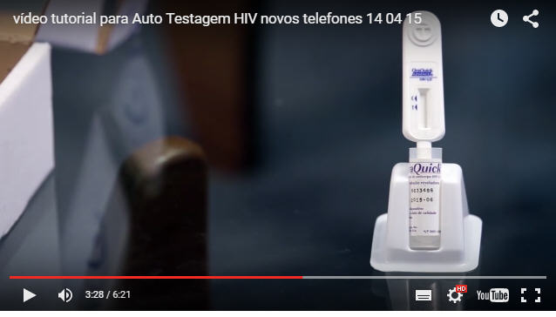
HIV Self-Testing Lessons Learned
HIVST kits
    Oral fluid (OraQuick®) T
    Two HIVST may be requested every 6 months
    Delivered by regular mail (identification needed) or retrieved in public pharmacy (anonymous)
Step-by-step video
Written test instructions
24/7 hotline is available
Communication and information technologies promising in attracting young MSM who value anonymity and privacy
    With time, new technologies might reach those with lower schooling and income
    Useful for those never tested and for high risk MSM needing frequent testing
High cost of mail delivery and the lower pharmacy uptake in Curitiba
Return of testing results could be improved
Notes:
Oral fluid Oraquick tests could be ordered on-line up to twice a year.
The study showed that communication and information technologies are promising in attracting Young MSM who value anonymity and privacy, particularly those never tested and those at high risk who need frequent testing. It also showed that mail delivery is costly, and that the return of testing results should be improved through other means.

Slide 38

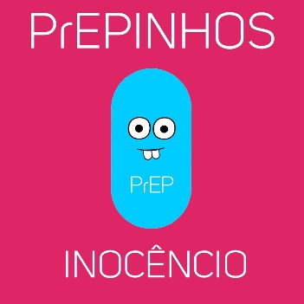
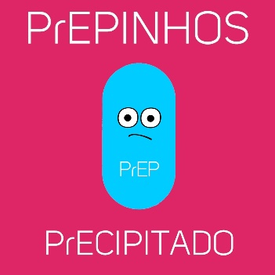
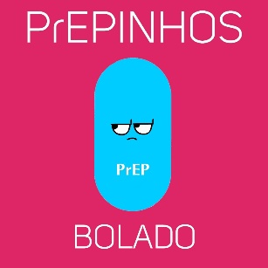
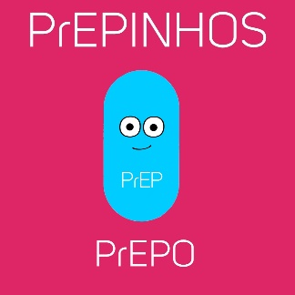

PrEP15-19
Demonstration Project aimed at Young MSM and TW 15-19 y.o. in Salvador, Belo Horizonte and Sao Paulo
Components:
  Formative study
  Strategies for recruitment, enrollment and linkage to prevention
  Combination prevention strategy
  HIV self-testing strategy
  Demonstration of PrEP effectiveness
  HIV incidence and cost-effectiveness
Still being implemented
  Regulatory issues delayed roll-out
AI: Amanda Selfie
Notes:
Currently I am part of the ImPrEP consortium, implementing a PrEP demonstration Project, ImPrEP, focused on MSM and Transwomen 18 y.o. or older in Brazil, Mexico and Peru, funded by UNITAID. A sister Project started in Brazil around the same time, in 2017. Led by University of Bahia, it is called PrEP 15-19, and focuses on Young MSM 15-19 years old.
This Project incorporates a very sophisticated communications component, to appeal to Young MSM. For example, they have created Amanda Selfie, an AI character who will guide Young MSM through information and appointments.
Project implementation in Brazil has been delayed as conducting sexuality-related research with minors is still challenging in the region.

Slide 39
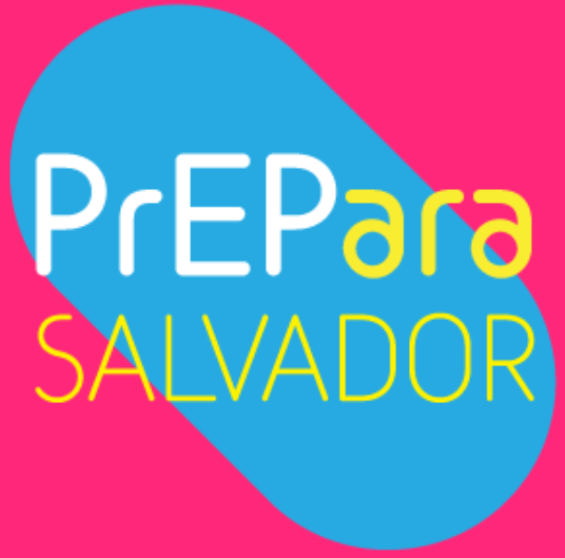


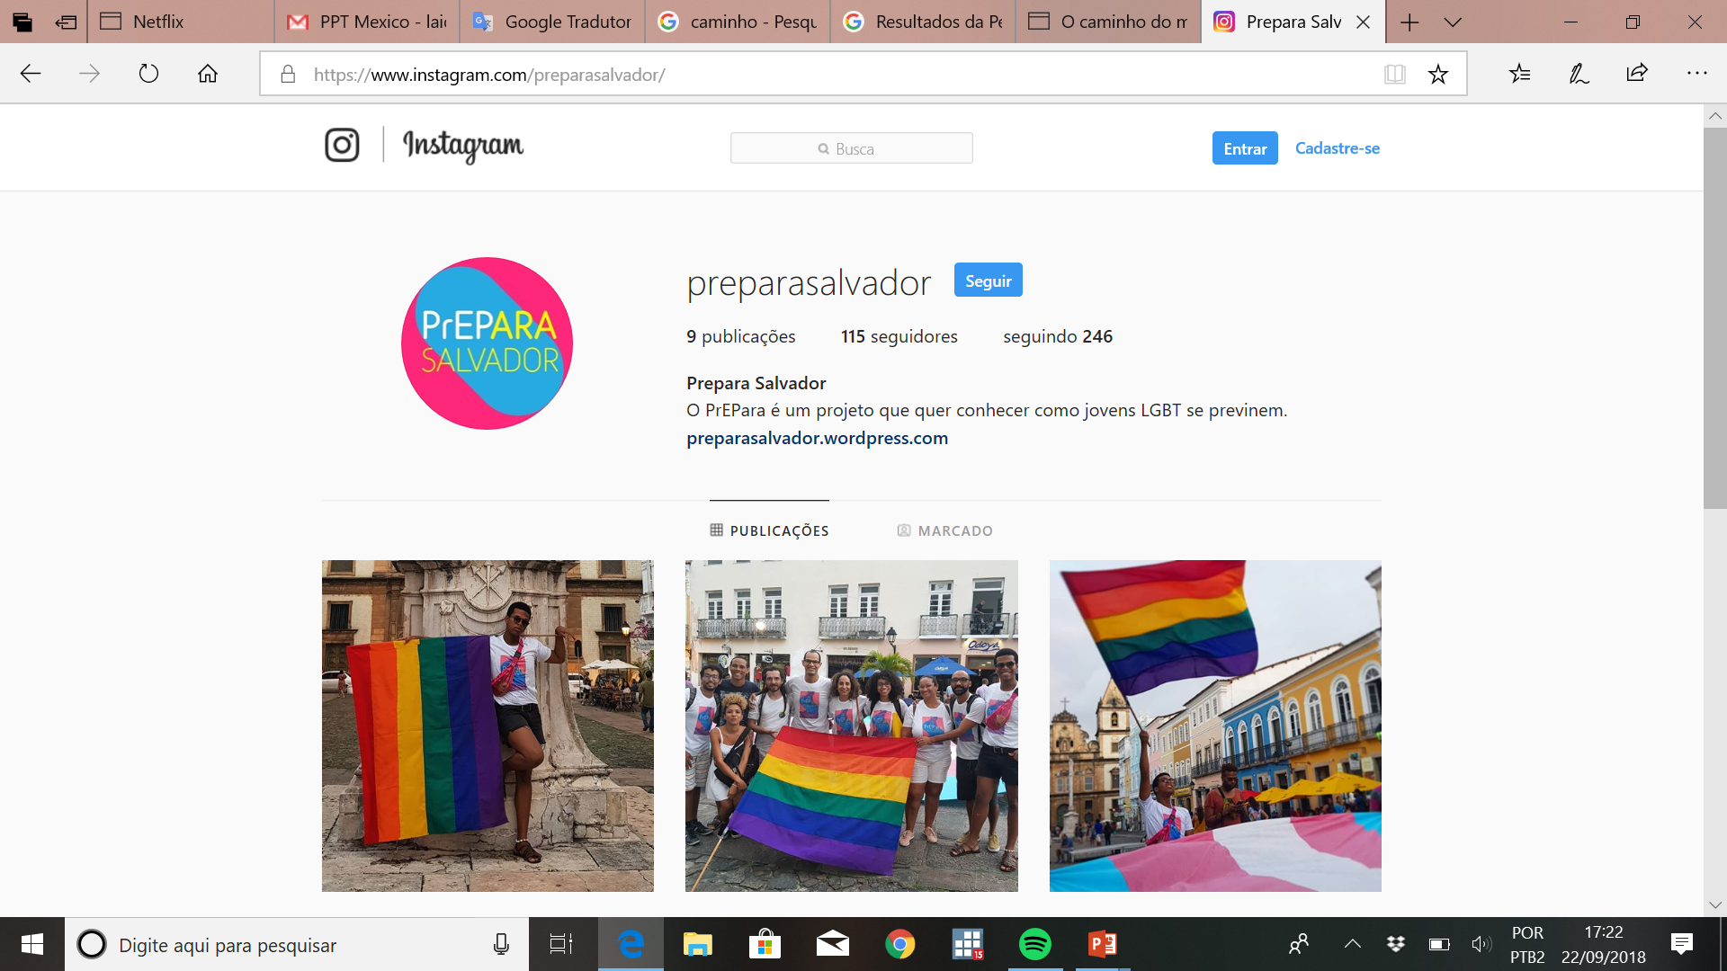
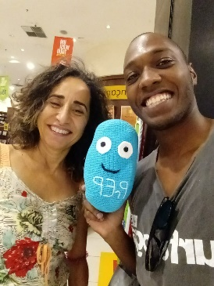
LGBT youth parties and gathering places were identified as important venues to PrEP recruitment.
Most did not feel discriminated against in schools, but complained for the absence of sex/HIV education
Few of them knew about PrEP. However, all interviewees were willing to use and to participate in the demonstration project.
Peer education identified as important strategy to guarantee recruitment.
The use/participation in social networks as strategies to recruit these groups was highly valued
Consistent condoms use in anal sex (though inconsistent use with steady partners or under the effect alcohol) was referred as the only strategy for HIV prevention.
61.0% did not know about PrEP before the study; 80.5% were willing to use PrEP upon awareness.
Factors associated with PrEP knowledge were: older age; recruitment at youth LGBT parties, at LGBT gathering/venues vs at schools; higher education; perception of AIDS as non-serious.
Findings of Formative Study
Notes:
Their formative study shows interesting information both about young MSM’s expectations and about their willingness to participate in the study. Please visit their oral and poster presentations at this conference.

Slide 40
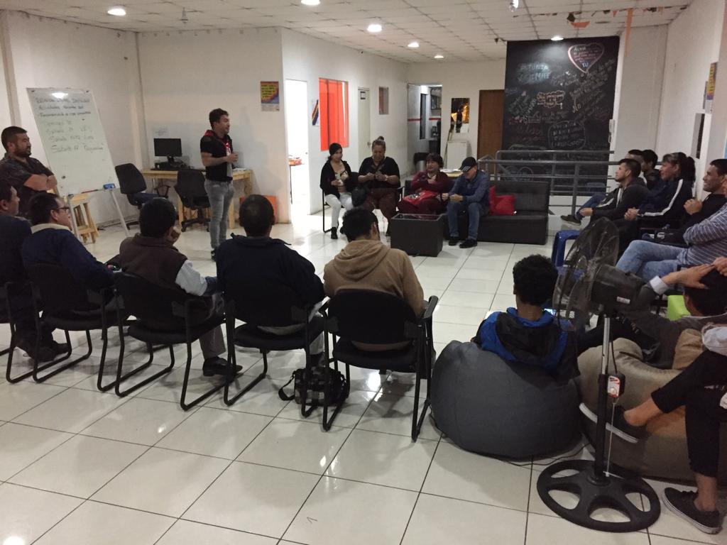



Community Mobilization: Orgullo +
Ongoing clinical trial with MSM and transwomen in Lima, testing a 3-yr intervention that comprises a community component (Generación Actual) adapted from Mpowerment, and a Health Systems component (aimed at linkage and adherence). Here we focus on the Community Component.
Core Elements
Grupo Impulsor (GI): Leadership Group
Community Center (where most activities occur)
Mobilization Activities (activities to draw in MSM & TW)
Talleres (Small Group Sessions)
Informal Outreach (talking with and supporting friends about HIV prevention)
Ongoing Publicity (through Facebook, pamphlets, word-of-mouth)
Coordinators (staff who coordinate the program)
Evidence of potential effectiveness is already apparent in the process evaluation.
Notes:
Let’s move on to Orgullo +, an ongoing clinical trial with MSM and transwomen in Lima, Peru, testing a 3-yr intervention with a community component and a health systems component, that we are conducting in collaboration with UCSF. The community component, Generacion Actual, is adapted from the Empowerment Project, developed by Dr. Susan Kegeles, also Co-PI in this study. The core elements of this community component involve a leadership group, a community center, mobilization activities, such as those shown here; workshops, informal outreach, ongoing publicity, and a staff of two coordinators. The ongoing process evaluation has produced some early evidence of potential effectiveness.

Slide 41
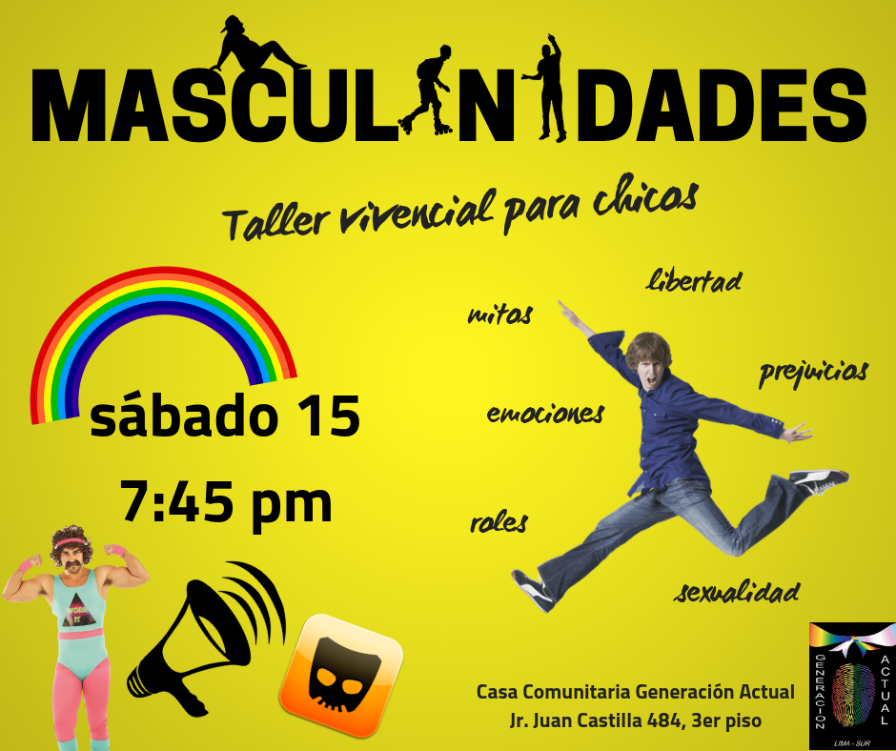
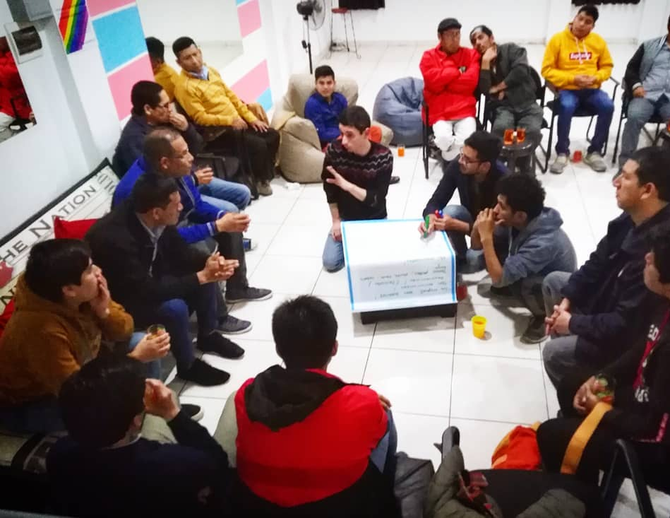
Young MSM Like Generación Actual
Not limited on MSM. Over time, involvement of Young MSM <25 has increased, potentially because of the following:
HIV-Related
Learning about HIV/STIs and condom use;
Increased testing and engagement in care
Increased self-efficacy for HIV prevention, testing and care
Normalizing HIV as a chronic disease (instead of a death sentence)
Empowering beliefs/attitudes regarding HIV stigma, care engagement, treatment as prevention, internalized homophobia
Related to Personal Well-Being
Self-reflection and introspection/Individual empowerment
Project as a safe and welcoming social space to express themselves and come out. Going to the CC instead of being in the street
Learn from Coordinators and peers
Integration between younger an older participants (older men and transwomen become mothers/godmothers/godfathers)
Community building (in the absence of other resources)
Notes:
While the intervention is not limited to Young MSM, we have observed a considerable increase in their participation. Such increase seems related to several reasoms, not only including the many HIV-related resources that the program offers, concerning information, increased access to testing and linkage to care, and group work to deal with stigma. There are also factors related to increased opportunities and resources for personal development and well-being in a safe and welcoming social space, where friendly interaction with older men and transwomen, and with the coordinators is appealing to those who have eyes to see and ears to hear.

Slide 42
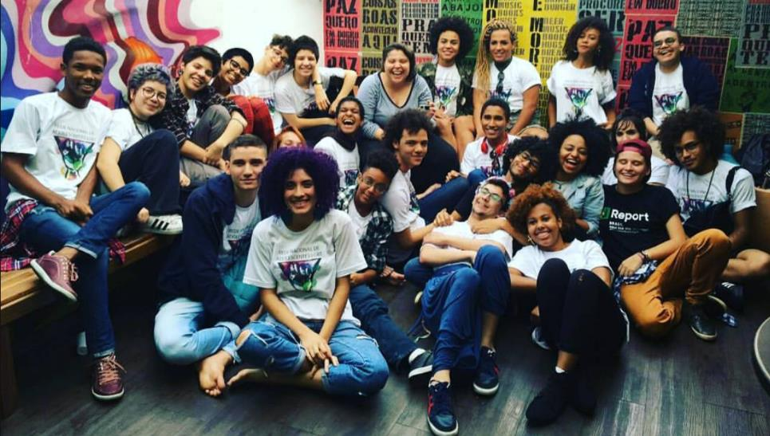

PROGRAM DESCRIPTION
Leadership training to 30 LGBT adolescents who were identified as leaders in their regions and disseminated their knowledge on LGBT rights at the local level. A new round of leaders were selected at a second moment through online tools
Online presence: FB, YouTube, Website, life stories, book
Advocacy and public presence - National Congress, Human Rights and Education ministries, civil society events and social media
The Voice of Brazilian LGBT Adolescents
RESULTS
More visibility to an under-represented group of adolescents who have the same rights to be themselves, learn, play, be protected by their families and communities, interact with their peers etc., but are discriminated against.
Contributed to a public debate on diversity and adolescent rights having adolescents as key speakers, not victimized
Promoted peer-support from adolescents who have access to information related to their rights and those who lack it.
Contributed to bridge the gaps between LGBT adolescents and decision makers
Gabriela Mora, Adolescent & Youth National Officer UNICEF Brazil
© UNICEF/BRZ/Fernando Martinho
Notes:
Finally, UNICEF conducted a pilot project focused on leadership training of 30 LGBT adolescents who were natural leaders in their regions in Brazil, and a new round at a later time, through online tools. The Project had online presence through various social media and websites, and conducted advocacy in various public spaces.
The team indicates that the Project achieved more visibility for this group, contributed to the public debate on sexual diversity, mediated the provision of peer support from the trained leaders to other adolescents, and overall bridged crucial gaps.

Slide 43
Take-Home Messages
Notes:
Let me conclude with a few take-home messages.

Slide 44
The Problem
Significant HIV/STI problem among MSM 15-24 in LA
  HIV prevalence: 5-10%; proxy for HIV incidence: Around 3%/yr
  Increased proportion of infections in past 10y
Conditioned by a context of:
  High sexual risk
  Low access to prevention (including PrEP)
  Decay in condom use without roll-out of PrEP
  Increased frequency of casual sex??
  Mental Health Issues
Notes:
Today we have gone through data indicating that there is a significant HIV problem among Young MSM in our region, with HIV and STI incidences similar to older MSM figures; while ART coverage among those diagnosed, and especially viral suppression of the latter, are much lower than among older MSM.
This alarming trend in the regional HIV epidemic is by no means recent – it has been going on for more than a decade. Sadly, news about epidemic growth among MSM, or among men in general, for that sake, have been more likely to remain unchecked in the global HIV discussions, as if connections with the circulation of HIV among women did not exist.
Its immediate determinants include an increase in the numbers of sexual acts and of casual partners, in the context of a fall in condom use without meaningful roll-out of PrEP. Drug use to enhance sexual activity is also common. Young MSM report practices similar to those of older MSM, and in fact report more frequent mental health issues, also generally neglected.

Slide 45
The Causes
Higher-level determinants:
  Legal barriers
  Sexualized mainstream culture dominated by the internet
  Quickly changing gay sexual culture that promotes an increased focus on sex and new technologies that facilitate sexual hook-ups (possibly dehumanizing sex in the process)
  Failure in sex education (not responding to the actual context)
  Lack of a community discussion of sexual ethics
  Limited interventions/programs to respond to the epidemic in this group
Notes:
The key determinants of this problem include the legal and other structural barriers that minors and others face to access testing and sexual health services; a highly sexualized mainstream culture facilitated by the internet; a commodified, quickly changing gay sexuality; policies of sex education that are generally insufficient vis à vis the emerging sexual issues; the lack of visible, nurturing communities where young MSM could learn critically how to make informed decisions about their lives and sexualities; and limited appropriate interventions and programs for this group.

Slide 46
The Needs
Need for:
  Remove legal barriers to access,
    Right balance between the protection of minors (from abuse, trafficking) and recognition of their sexuality and autonomy
  Provide effective education and information,
    Do not restrict access (e.g to the internet), but help young people develop the capacity to assess what they want and what is good for them
  Creatively improve access to care
    Optimize public services, but recognize their ‘natural’ limits
    Work with communities (e.g. community centers) without duplication, seeking sustainability. Communities can deliver and do not need our condescendence.
Notes:
In that context, we need a few critical things. First, we need to remove absurd legal barriers that minors face when they seek health care. We should always seek the right balance between the protection of minors from abuse and trafficking, and recognition of their sexuality and autonomy.
We also need to offer really meaningful sex education, with content that can help the young in the current context. Maybe our education would look completely different from what it is now. And definitely we should not restrict internet access – we know where it leads to. Rather, we should help young people develop skills to assess their own needs and decide.
Then we should improve the access to prevention and care services, doing as much as we can in the public settings, to creatively reach young MSM with strategies such as those used by The Time is Now and PrEP15-19.
We also need to recognize the natural limitations of the public sector, and identify appropriate ways of working directly with communities (and fund their work), possibly under the models developed by Orgullo and UNICEF. And communities can deliver; they don’t need our condescendence.

Slide 47
The Needs
Need to:
  Avoid the reduction of the community to a market segment: Build a nurturing community, discuss/educate (humanize sex)
  Recognize and celebrate difference but also identify and emphasize on similarities among young MSM, young Men, young people in general.
Notes:
It is also crucial to avoid the takeover of commercial interests, and the reduction of the community to a market segment. A community should nurture and educate the young; it should generate safe and balanced spaces for discussion of ideas, where different thinking is respected. The point is, how could sexuality contribute to happier, more fulfilling, more humaine lives…
Finally, we should recognize and celebrate differences, while at the same time identify and emphasize similarities, say, between young MSM and young men in general, or between them and young people in general. It is easier for them than it is for us, in fact.

Slide 48
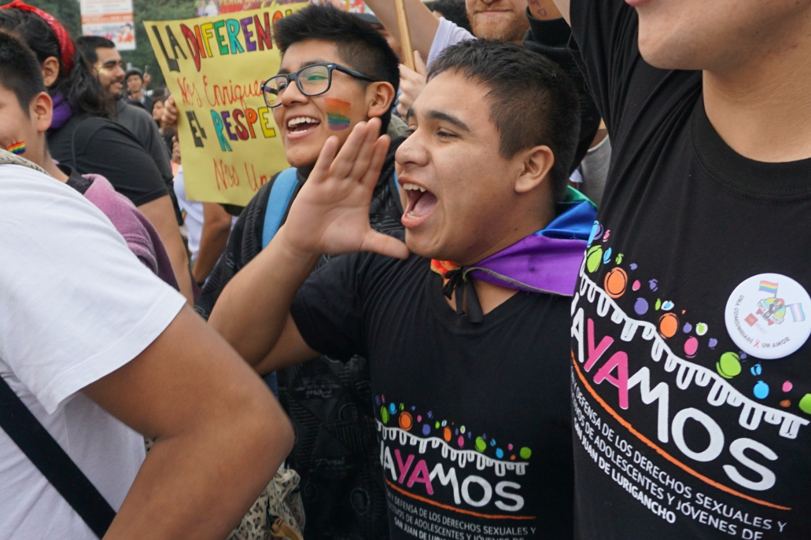
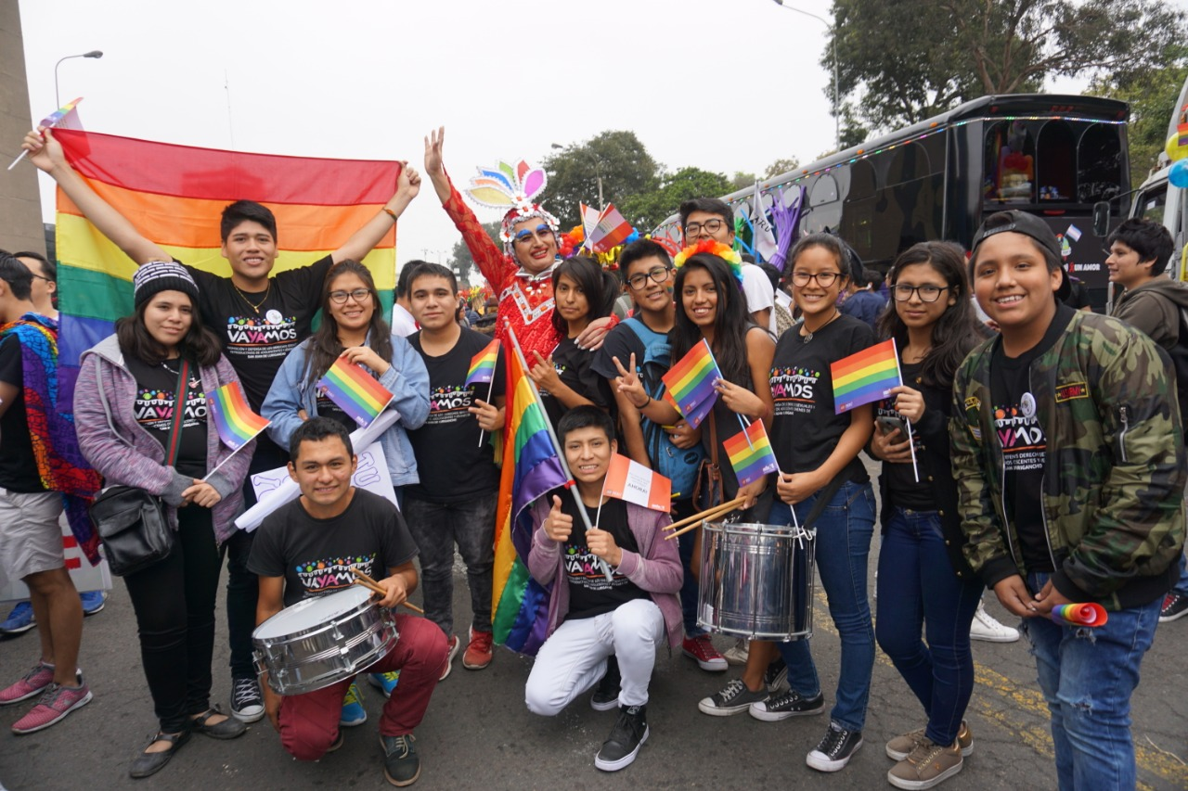
¡Gracias!
Notes:
This is, for example, Vayamos San Juan, a non-LGBT youth music group. They were great in the recent gay pride celebration in Lima.
Our world today is full of unnecessary conflicts that never get resolved. If we learned to work together in more fields, and acknowledge that we are all human beings with similar needs and dreams, we could save a great deal of energy that could be used, indeed, in making everybody’s lives happier, more fulfilling, and more humaine.
Thank you very much!

